Slide 1
Time Consumption Analysis
Team Detail
Mentor : Dr.G Sai krishnan
Vishnu S
Antony Santhan Raj A
Abhishai Anandaraj J
Tamilarasan C
Swaminathan K S
Athithya T
Jayashri
Vishal J
Reshma R
Rahavi S

Slide 2
ACTION TAKEN REPORT
During the previous meeting, the following recommendations were made:
It was recommended to conduct a Time Dependent Pattern Recognition.f
Enhance inventory management processes.

Slide 3

Time Consumption Analysis
We discovered that the service station offers three primary service types: Preventive Maintenance Service (PMS), Repair and Replacement (RR), and Breakdown Assistance and Parts Procurement (BANDP).
In the Phase 4 analysis, we analyzed three months of service center data and encountered around 3,469 service records, which we analyzed using 17 different technicians.
We analyzed data attributes that included entry date and time, ready date and time, service type, car model, and technician who worked on the car.
Statistical Analysis:
Our next analysis is a statistical model, one-way ANOVA classification. This analysis gave us insight into the service time of different service types in comparison to one another.
The service type with the longest average time was Repair and Replacement (RR), followed by Breakdown Assistance and Parts Procurement (BANDP).

Slide 4
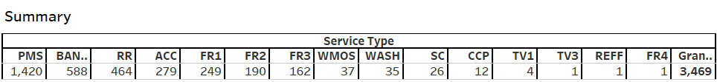
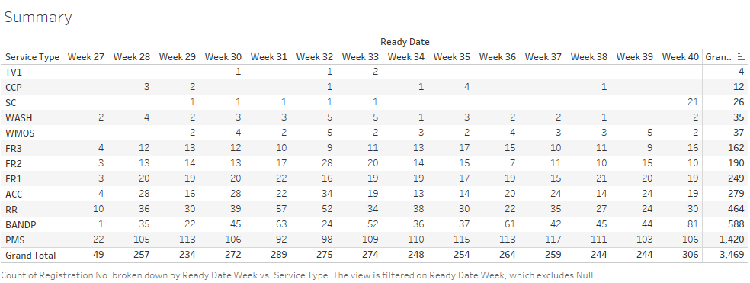
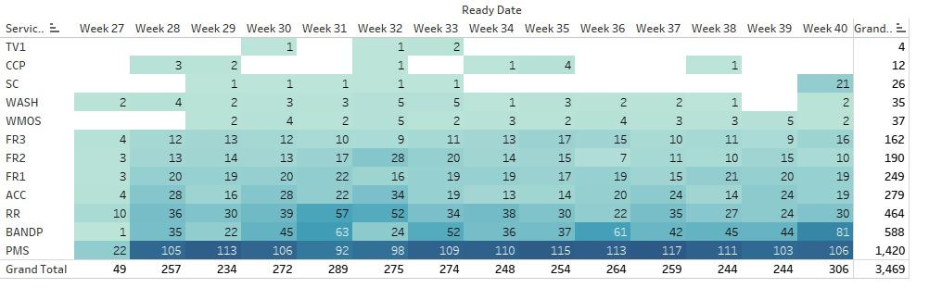
We analyzed the Service that done in the service station in each & every service that done in the past 3 months data , in primarily the station encountered most of the service in the Preventive Maintenance Service (PMS), Repair and Replacement (RR), and Breakdown Assistance and Parts Procurement (BANDP).
We have done the analysis in week wise over the three month period of time , we found service that encounter by the station is almost consistent in the over period of time .

Slide 5
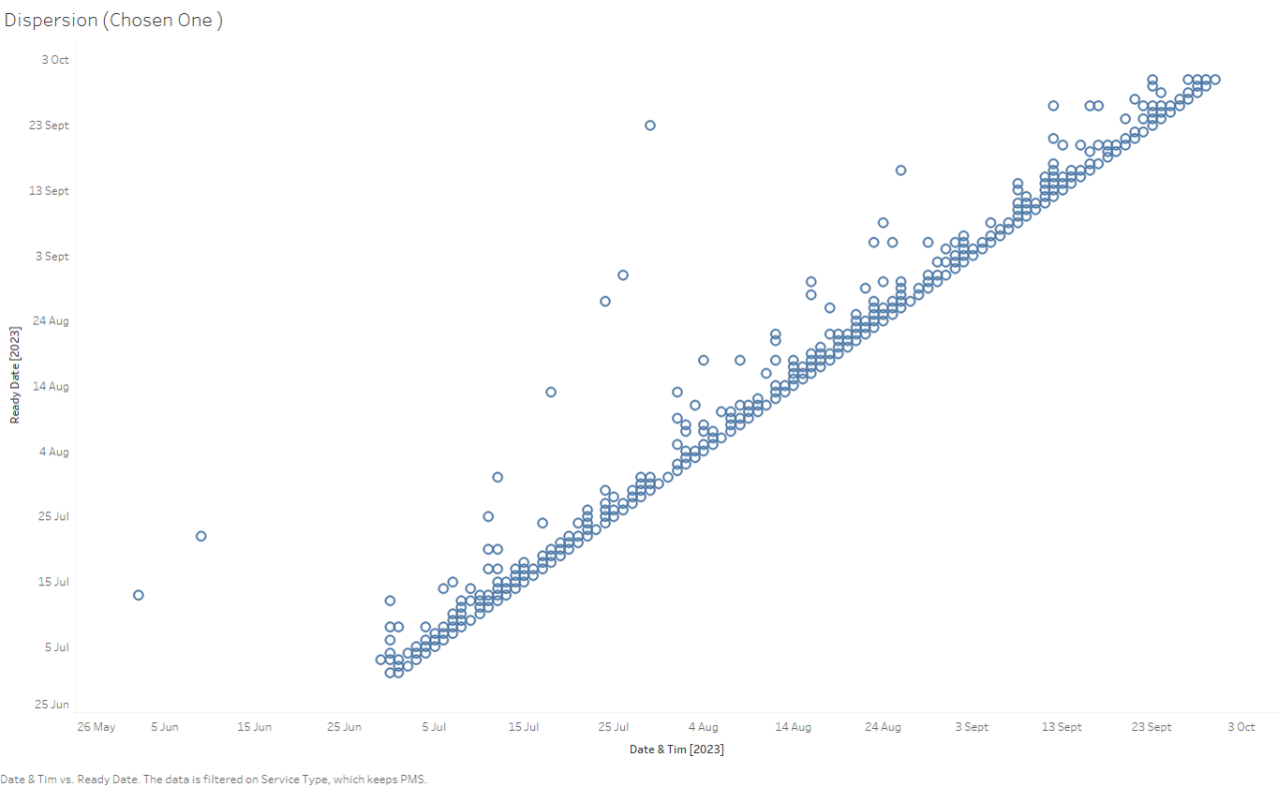
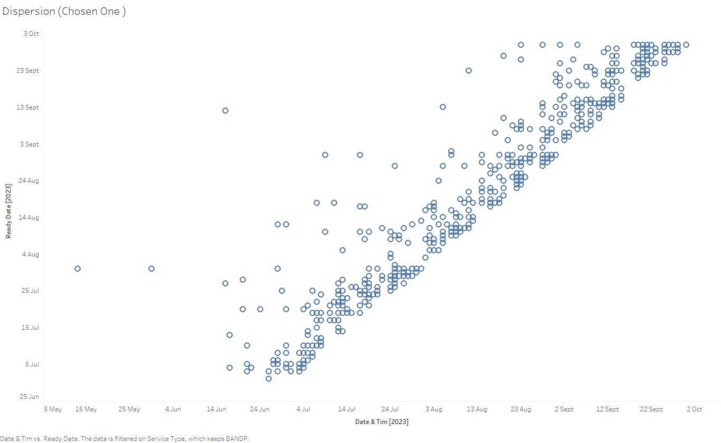
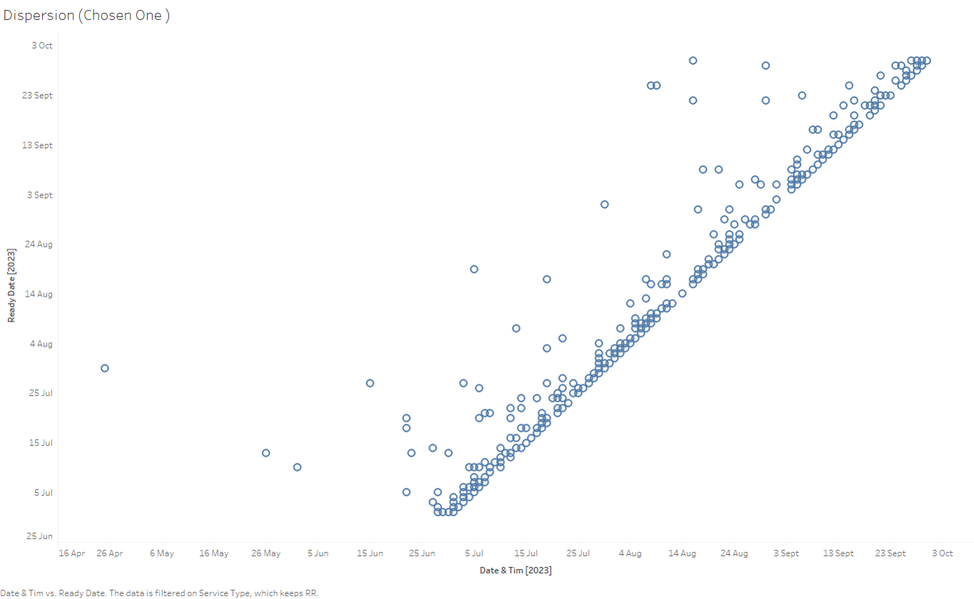
Dispersion In Completing BANDP Service
PMS
RR
In the scatter plot depicting the duration of BANDP service from car arrival to completion, we noticed a significant dispersion. BANDP, which accounted for 57% of service time among 588 encounters, was managed by a single technician.
The scatter plot shows a relatively tight distribution of PMS service times. On average, PMS service accounted for 19.67% of the total service time for the car during its service life.

Slide 6

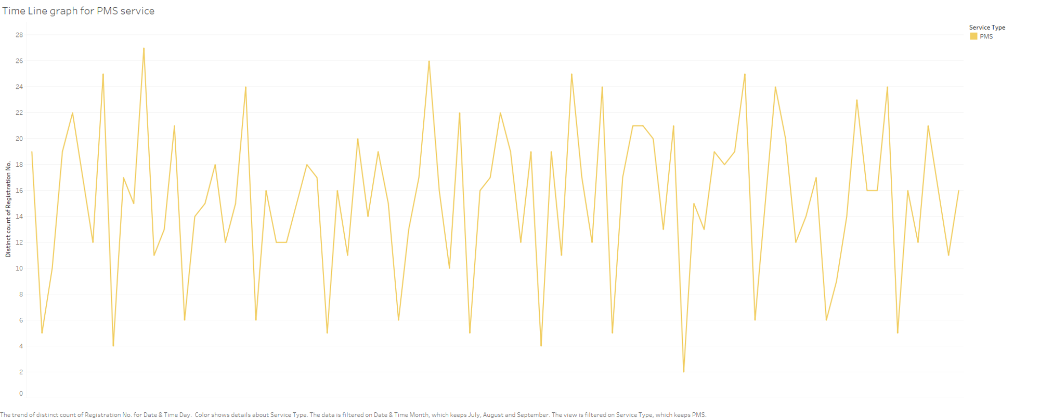
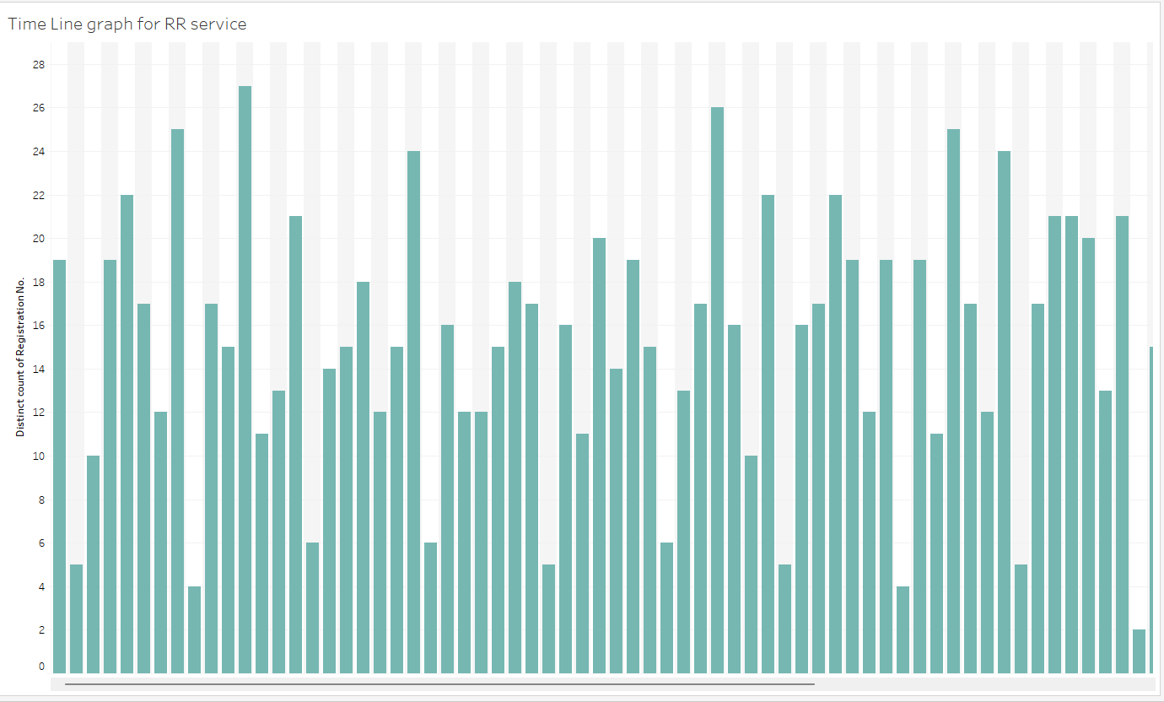
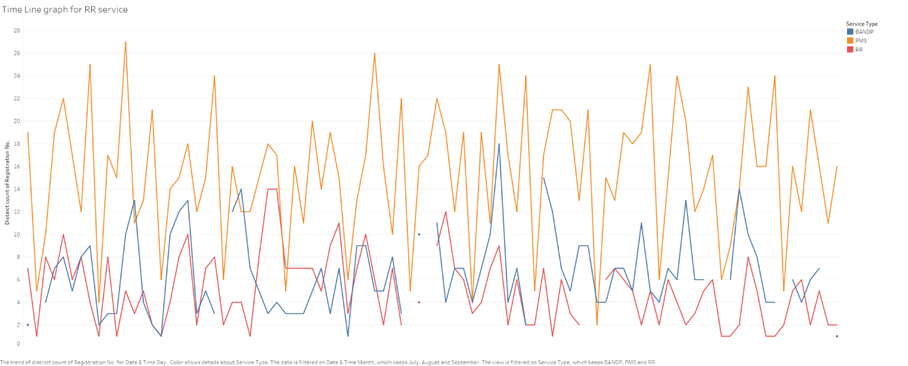
Timeline for Services that encountered
Sunday
Wednesday
Saturday
Week 1
Week 2
Week 3
Week 4
Week 5
Week 6
Week 7
Week 8
Week 9
This graph represents the data wise analysis of car services requests based on their service type. Through the graph we can see that there is pattern when we consider the PMS services, which is Periodic maintenance service. It spikes on Wednesdays and Saturdays, while have minimum requests on Sundays .It indicates that we can expect low encounters in Sunday and high encounters in Wednesday and Saturday in a week .

Slide 7
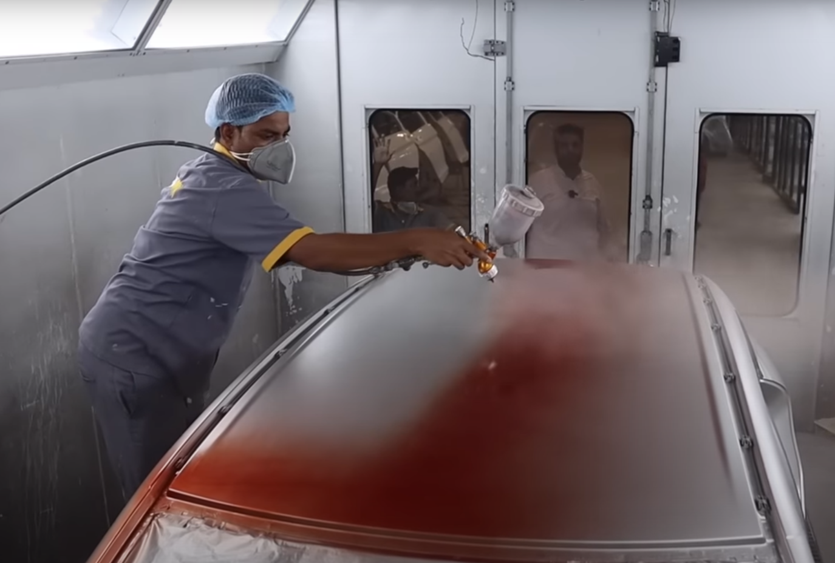
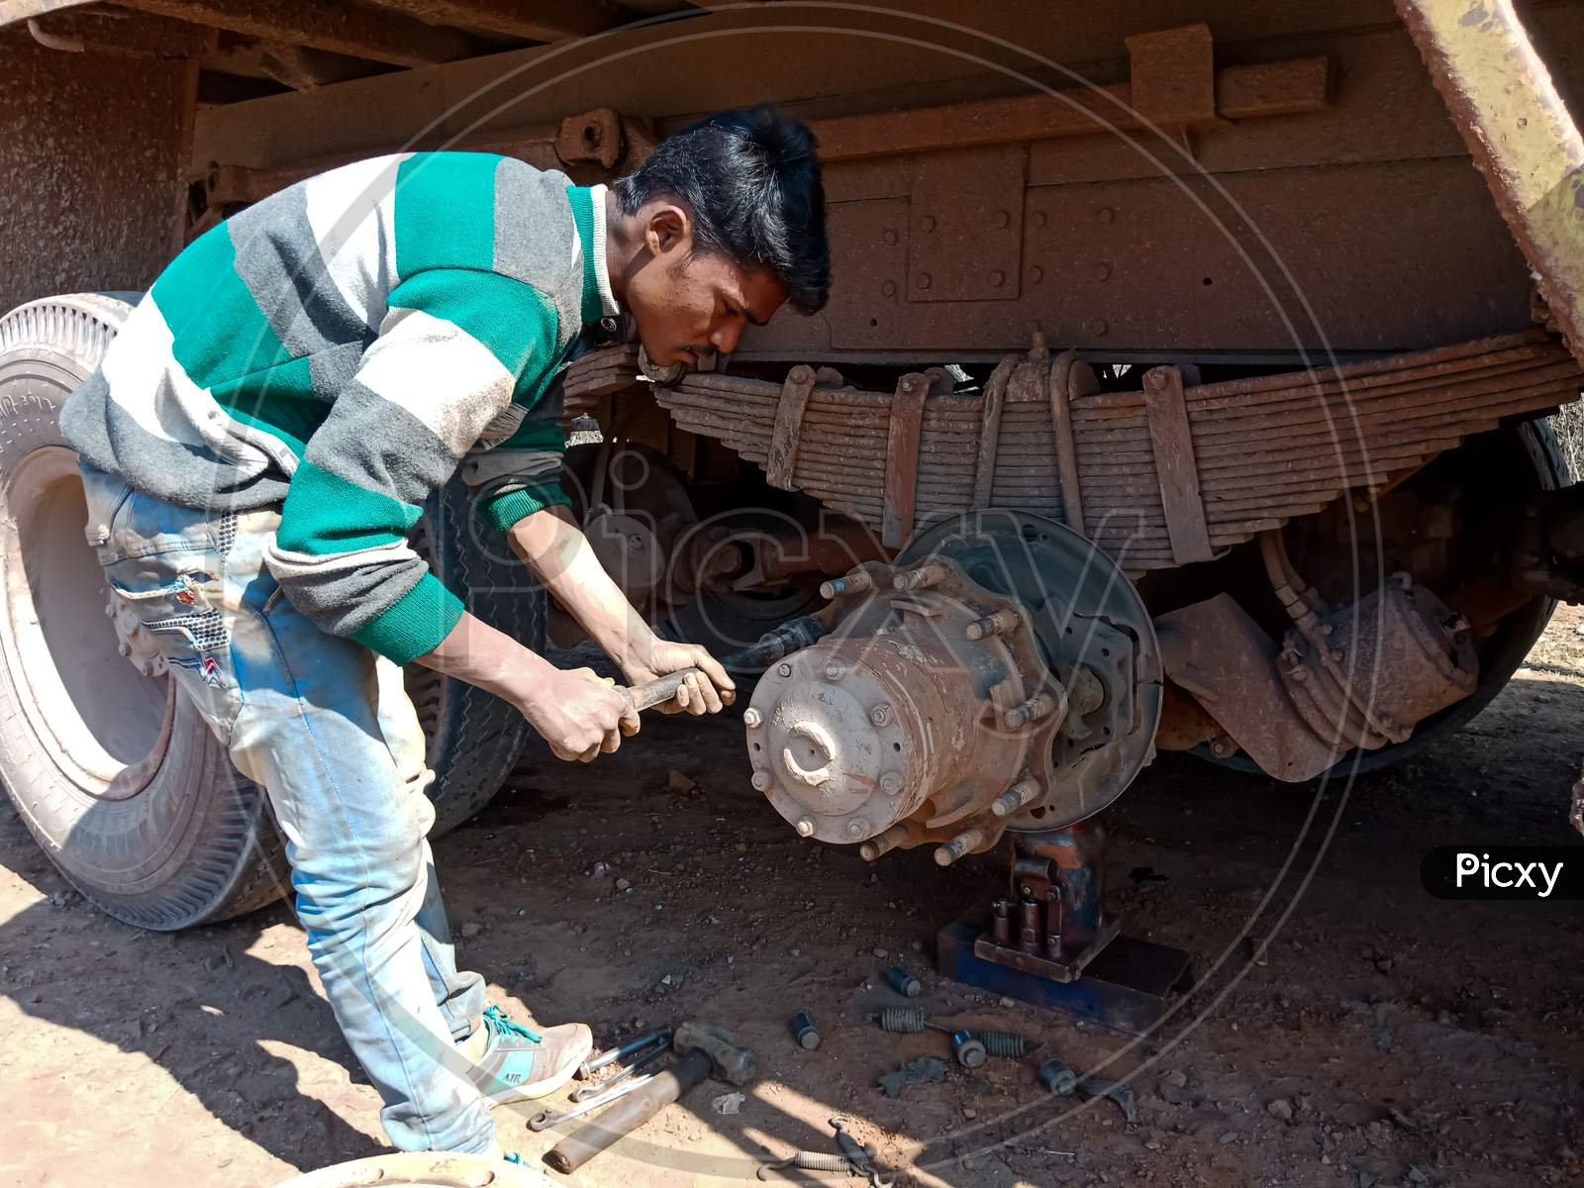

Challenges :
Most of the works in the BANDP service need to be done manually such as Color Spraying ,Parts Changing etc.. It results in the high time consumption in the workflow ,particularly the BANDP service have low number of technicians to handle
Low and unexperienced Technicians : We came to know most of the worker in the BANDP service are inexperienced and had no prior knowledge about the work , This results in inconsistency and delay in the workflow
Repetitive Motion Disorders: These injuries result from constant stress on one part of the body. For example, workers who repeatedly have to turn manual screwdrivers put excessive pressure on their wrists.
Chemical Exposure: Along with the particles and dust produced by grinders, polishers, buffing machines and other equipment, the respiratory systems, eyes and skin of workers are at risk of damage.

Slide 8
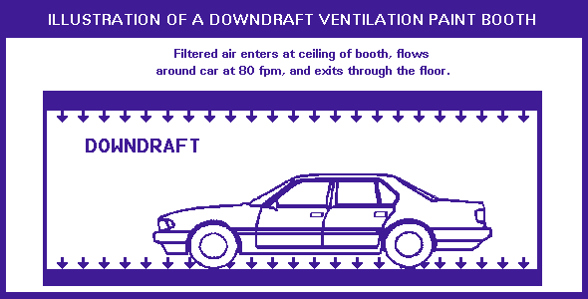
Recommendation :
Hazard - Autobody workers may develop nervous disorders, skin and eye irritation, respiratory sensitization, asthma and reduced lung function from exposure to paint.
Effective control Measures
DOWNDRAFT VENTILATION spray painting booths are recommended instead of Cross Draft or Semi-Downdraft Ventilation spray painting booths. Properly operated DOWNDRAFT booths produce lower concentrations of paint overspray compared to the other two types of booths. DOWNDRAFT booths produce a cleaner paint job that requires less buffing.

Slide 9

Revolutionizing Car Service Supply Chain Management with RPA
Discover the power of Robotic Process Automation (RPA) in optimizing car service companies' supply chain management processes and enhancing performance.

Slide 10
Meet the Challenge Head On: RPA in Supply Chain Management
RPA is the game-changing technology that can revolutionize the supply chain management (SCM) landscape in car service companies. The technology offers a cost-effective and efficient way to enhance business processes to meet the unique supply chain management challenges of car service companies.
1
Reduced Labor Costs
2
Increased Accuracy and Visibility
3
Streamlined Operations
RPA offers an efficient and cost-effective way to automate repetitive and standardized tasks, thus freeing up valuable resources for other business needs.
RPA can improve data accuracy and provide enhanced visibility across the supply chain management process. This can help car service companies make smarter business decisions and improve their service delivery to customers.
RPA can streamline operations by standardizing processes, creating workflows, reducing error rates, and improving productivity.

Slide 11
Car Service Companies Challenges: Meet RPA Solutions
Car service companies face challenges related to managing suppliers, maintaining inventory, and delivering timely services to customers. Automation with RPA offers them an avenue to accelerate their supply chains and help meet critical business objectives.
1
Supplier Management
Automate supplier data collection and management, supplier selection processes, and custom relationship management with one tool - RPA.
Inventory Management
2
Automate inventory forecasting, monitoring, and control processes to minimize inventory losses and stock-outs, improve order fulfillment time, and save cost.
3
Timely Service Delivery
Automate the process of scheduling appointment delivery, customer communication and mapping of journey for simplicity and accuracy.

Slide 12




Conclusion: A Brighter Future with RPA
RPA in supply chain management for car service companies provides the perfect solution to address the unique needs of the industry. By streamlining operational processes, reducing costs, and increasing data accuracy and visibility, the technology car service companies an unprecedented opportunity to optimize SCM processes across all departments. offers
Increased Efficiency and Productivity
Enhanced Data Accuracy and Visibility
Cutting-Edge Technology
RPA frees up valuable human resources for other business needs and positions car service companies for increased productivity and profitability.
RPA can significantly increase data accuracy and allow for better-informed SCM decision-making.
RPA is the cost-effective and efficient solution to propel your car service company SCM forward into the future.

